Slide 1



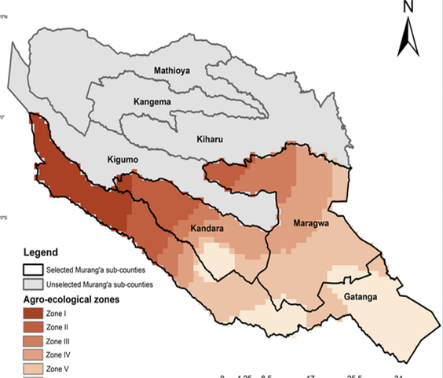
Establishment and Digitalisation of Primary health Care Networks in Murang’a County, Kenya in 2023 to 2025
Dr. Kairo Kimende¹ , James Mburu² , Florence Kagwaini³ and Christopher Mwangi⁴
1,2,3,4: Murang’a County Department of Health, 3: Murang’a County Referral Hospital
BACKGROUND
Primary Health Care Networks (PCNs) have emerged as a key strategy for strengthening healthcare delivery in Kenya towards achieving universal health coverage. In Murang’a County, nine PCNs were established between 2023 and 2024, linking 165 health facilities across the county. These networks were subsequently transformed into “smart PCNs” through the digitalisation of all health systems, including patient records, referral pathways, reporting systems, telemedicine services, payment systems and administrative functions through investment in hardware, software and connectivity.
OBJECTIVE: To examine PCN establishment, digitalisation, and impact on healthcare delivery in Murang’a County.
METHODOLOGY: Retrospective longitudinal descriptive case study.
STUDY AREA: Murang’a, Kenya
STUDY DESIGN AND SAMPLING
Muranga County
Area: 2558KM2
Population: 1050,000
Sub counties: 9
Public Health facilities: 165
Below poverty line: 23.5%
Economic zones: 3 with farming as main
Design: | Retrospective descriptive case study (2023–2025)
Setting: | Murang’a County health system
Sampling: | Purposive
Scope: | Digitalisation in all 165 facilities.
INSERT MAP OR FIGURES
STATISTICAL ANALYSIS: Descriptive statistics used to summarise trends in service utilisation, referrals and facility revenue.
RESULTS
Involved deployment of ICT infrastructure, hardware, internet connectivity, satellite backup, HMIS mapping, solarization and power stabilisation across facilities.
1. DIGITISATION COMPONENTS:
2. REVENUE
DISCUSSION
Table 1: Hospital Monthly Revenue before & After Digitalisation
Facility | Revenue before (Ksh) | Revenue after (Ksh) | Percentage increase
Murang’a hospital | 1,960,000 | 11,200,000 | 470%
Maragua hospital | 600,000 | 3,000,000 | 400%
Kirwara hospital | 400,000 | 1,200,000 | 200%
Kangema hospital | 300,000 | 800,000 | 167%
Kigumo hospital | 350,000 | 1,100,000 | 214%
Muriranjas hospital | 450,000 | 1,150,000 | 156%
Kenneth Matiba | 500,000 | 1,500,000 | 200%
Kandara hospital | 300,000 | 1,000,000 | 233%
Average Increase |  |  | 255%
Nine PCNs with over 165 Public, Private and faith-based facilities formed hubs and spokes.
Electronic medical records opened the way for paperless services,
Digital payment & Procurement platform
Telemedicine enhanced access to specialist consultations
Data-driven live decision-making.
TAT tracking reduced delays in referrals.
Reduced congestion in major hospitals.
Facility revenues increased by 200%.
CONCLUSIONS
Advancement in healthcare delivery is digital.
Smart PCNs have strengthened integration, referral &disease surveillance
Revenue multiplication
Enhanced access to healthcare services.
Practical model for counties seeking to modernise primary healthcare through digital approaches.
Contact: kimende.kairo@gmail.com

